Slide 1
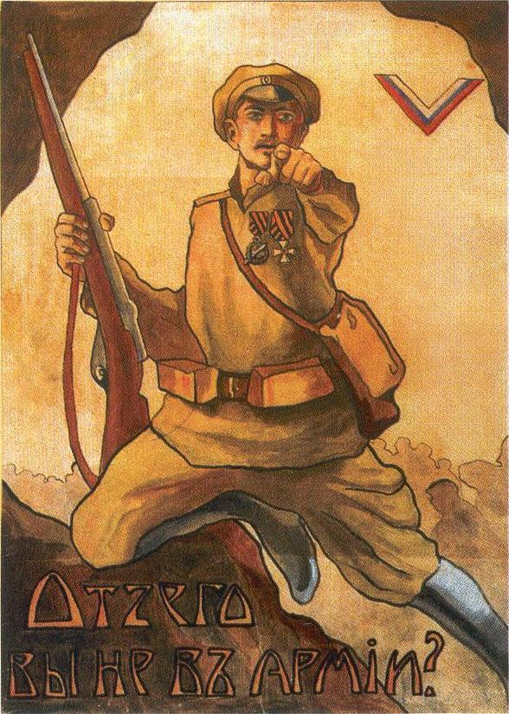

The Russian Revolution: Decision Point Simulation

Slide 2
Rules
Decisions can be made only using information available at the time. No hindsight!
You will have about 5 minutes to read the prompt and discuss with your neighbor. I will then post two options and have you vote based on your discussions.

Slide 3
Question:
Was the Bolshevik Revolution inevitable, or was it won and lost at specific moments?

Slide 4
Decision Point #1: February 1917
You are the commander of the Petrograd military garrison
It is February 26, 1917. For three days, workers have been striking and crowds have flooded the streets of Petrograd demanding bread and an end to the war. Tsar Nicholas II has sent you a direct telegram: “I order you to suppress from tomorrow all disorders on the streets of the capital.” The order is unambiguous.
But your troops are exhausted conscripts — many of them factory workers in uniform — and there are signs that their loyalty is fragile. You have no way of knowing whether they will obey if you give the order to fire. If they refuse in front of the crowd, you will have lost both control of your troops and control of the streets simultaneously.
Do you order your soldiers to fire on the crowds?
Notes:
What happens to military discipline if commanders start deciding which orders to follow? The garrison’s collapse is the hinge on which the whole February Revolution turns. The troops did refuse—and mutinied. Within days, the Tsar abdicated.

Slide 5
Decision Point #1
YES: A lawful order is a lawful order, and discipline depends on compliance.
NO: An order your troops won’t follow is worse than no order at all.

Slide 6
Decision Point #2: March 1917—You are a leader of the new Provisional Government
It is March 1917. The Tsar has abdicated. After years of autocracy, Russia has a chance to build a democratic government — and you are part of it. But Russia is still at war with Germany, and your Allied partners (Britain and France) are counting on you to stay in the fight. Many soldiers and workers want out of the war immediately. Staying in honors your commitments and signals that the new Russia is a reliable international partner. Leaving the war might bring peace — but it could also mean losing Allied financial support and looking weak at home and abroad. Do you keep Russia in World War I, or seek a separate peace with Germany?
Notes:
The Provisional Government chose to stay in the war, which fueled the “peace, land, bread” opposition that Lenin exploited. Both choices were genuinely defensible at the time.

Slide 7
Decision Point #2
STAY IN: Honor Allied commitments; show the new government can be trusted.
NEGOTIATE PEACE: End the suffering; consolidate the revolution at home first.

Slide 8
Decision Point #3: July 1917. You are Alexander Kerensky, head of the Provisional Government.
It is July 1917. A spontaneous armed uprising in Petrograd — the “July Days” — has just collapsed. The Bolsheviks, who half-heartedly supported it, look discredited. Lenin has fled to Finland. You have damaging (though possibly forged) documents suggesting the Bolsheviks received funding from Germany — Russia’s enemy.
The party is vulnerable. You could arrest the Bolshevik leadership and ban the party entirely. But you are trying to build a democratic government, not a repressive one. And some of your allies worry that cracking down too hard could backfire and generate sympathy for the Bolsheviks.
Do you arrest the Bolshevik leadership and ban the party?

Slide 9
Decision Point #3
YES: Eliminate them while you have the chance; the evidence justifies it.
NO: Show restraint and trust the democratic process; repression could backfire.

Slide 10
Decision Point #4: October 1917. You are Lenin, addressing the Bolshevik Central Committee
It is October 10, 1917. You have been hiding in Finland for months but have slipped back into Petrograd in disguise. You are pushing the Central Committee to launch an armed takeover of the government immediately. Two of your most respected colleagues — Zinoviev and Kamenev — are urging caution. They argue that the Bolsheviks don’t have enough popular support to hold power after a coup, and that patience will bring victory through elections.
You believe the moment is now or never: the Provisional Government is weak, soldiers are deserting the front, and peasants are seizing land without waiting for anyone’s permission. Every week of delay strengthens your opponents.
Do you proceed with the armed uprising, or wait for broader support?

Slide 11

Decision Point #4
ACT NOW: The window is open; delay will close it.
WAIT: Build a broader base first; a failed coup will destroy the movement.
Notes:
Lenin pushed forward. The actual seizure of the Winter Palace was nearly bloodless—which often surprises students conditioned to imagine a dramatic battle. Use that surprise to loop back to the anchor question about inevitability.

Slide 12

Question
Was the Bolshevik Revolution inevitable, or was it won and lost at specific moments?

